Slide 1

TEAM CAATY

Slide 2

Agenda
Team Introduction
Project Statement
Tech Stack & DevOp
Milestones & Recent progress
Problem During The Development
Demo
Thanks and Q&A?

Slide 3
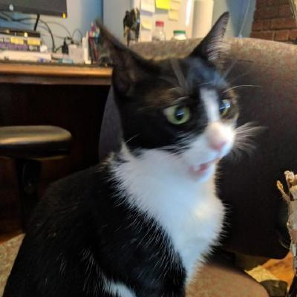
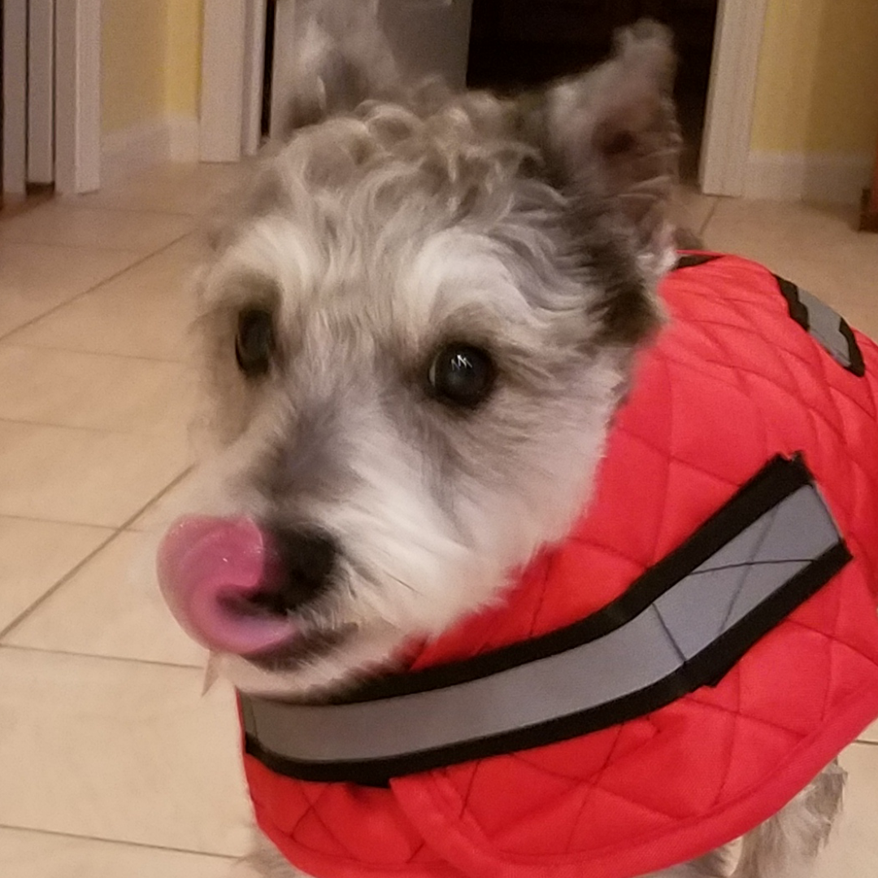
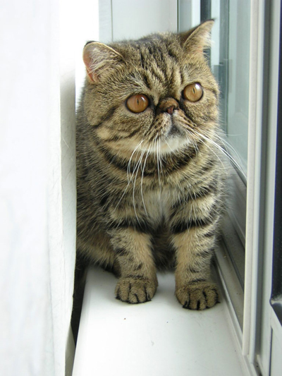
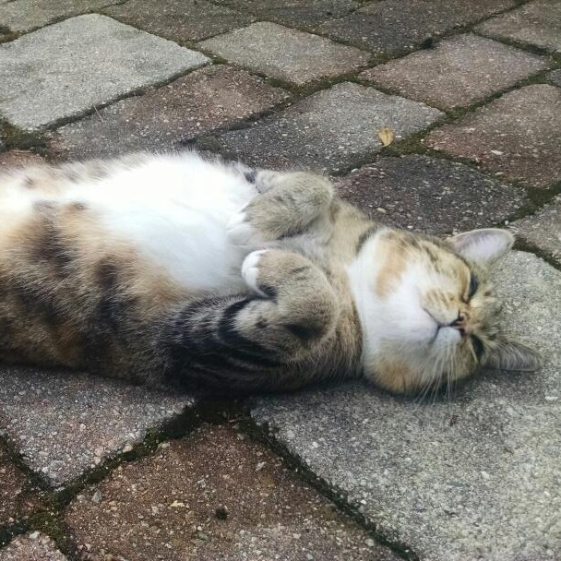
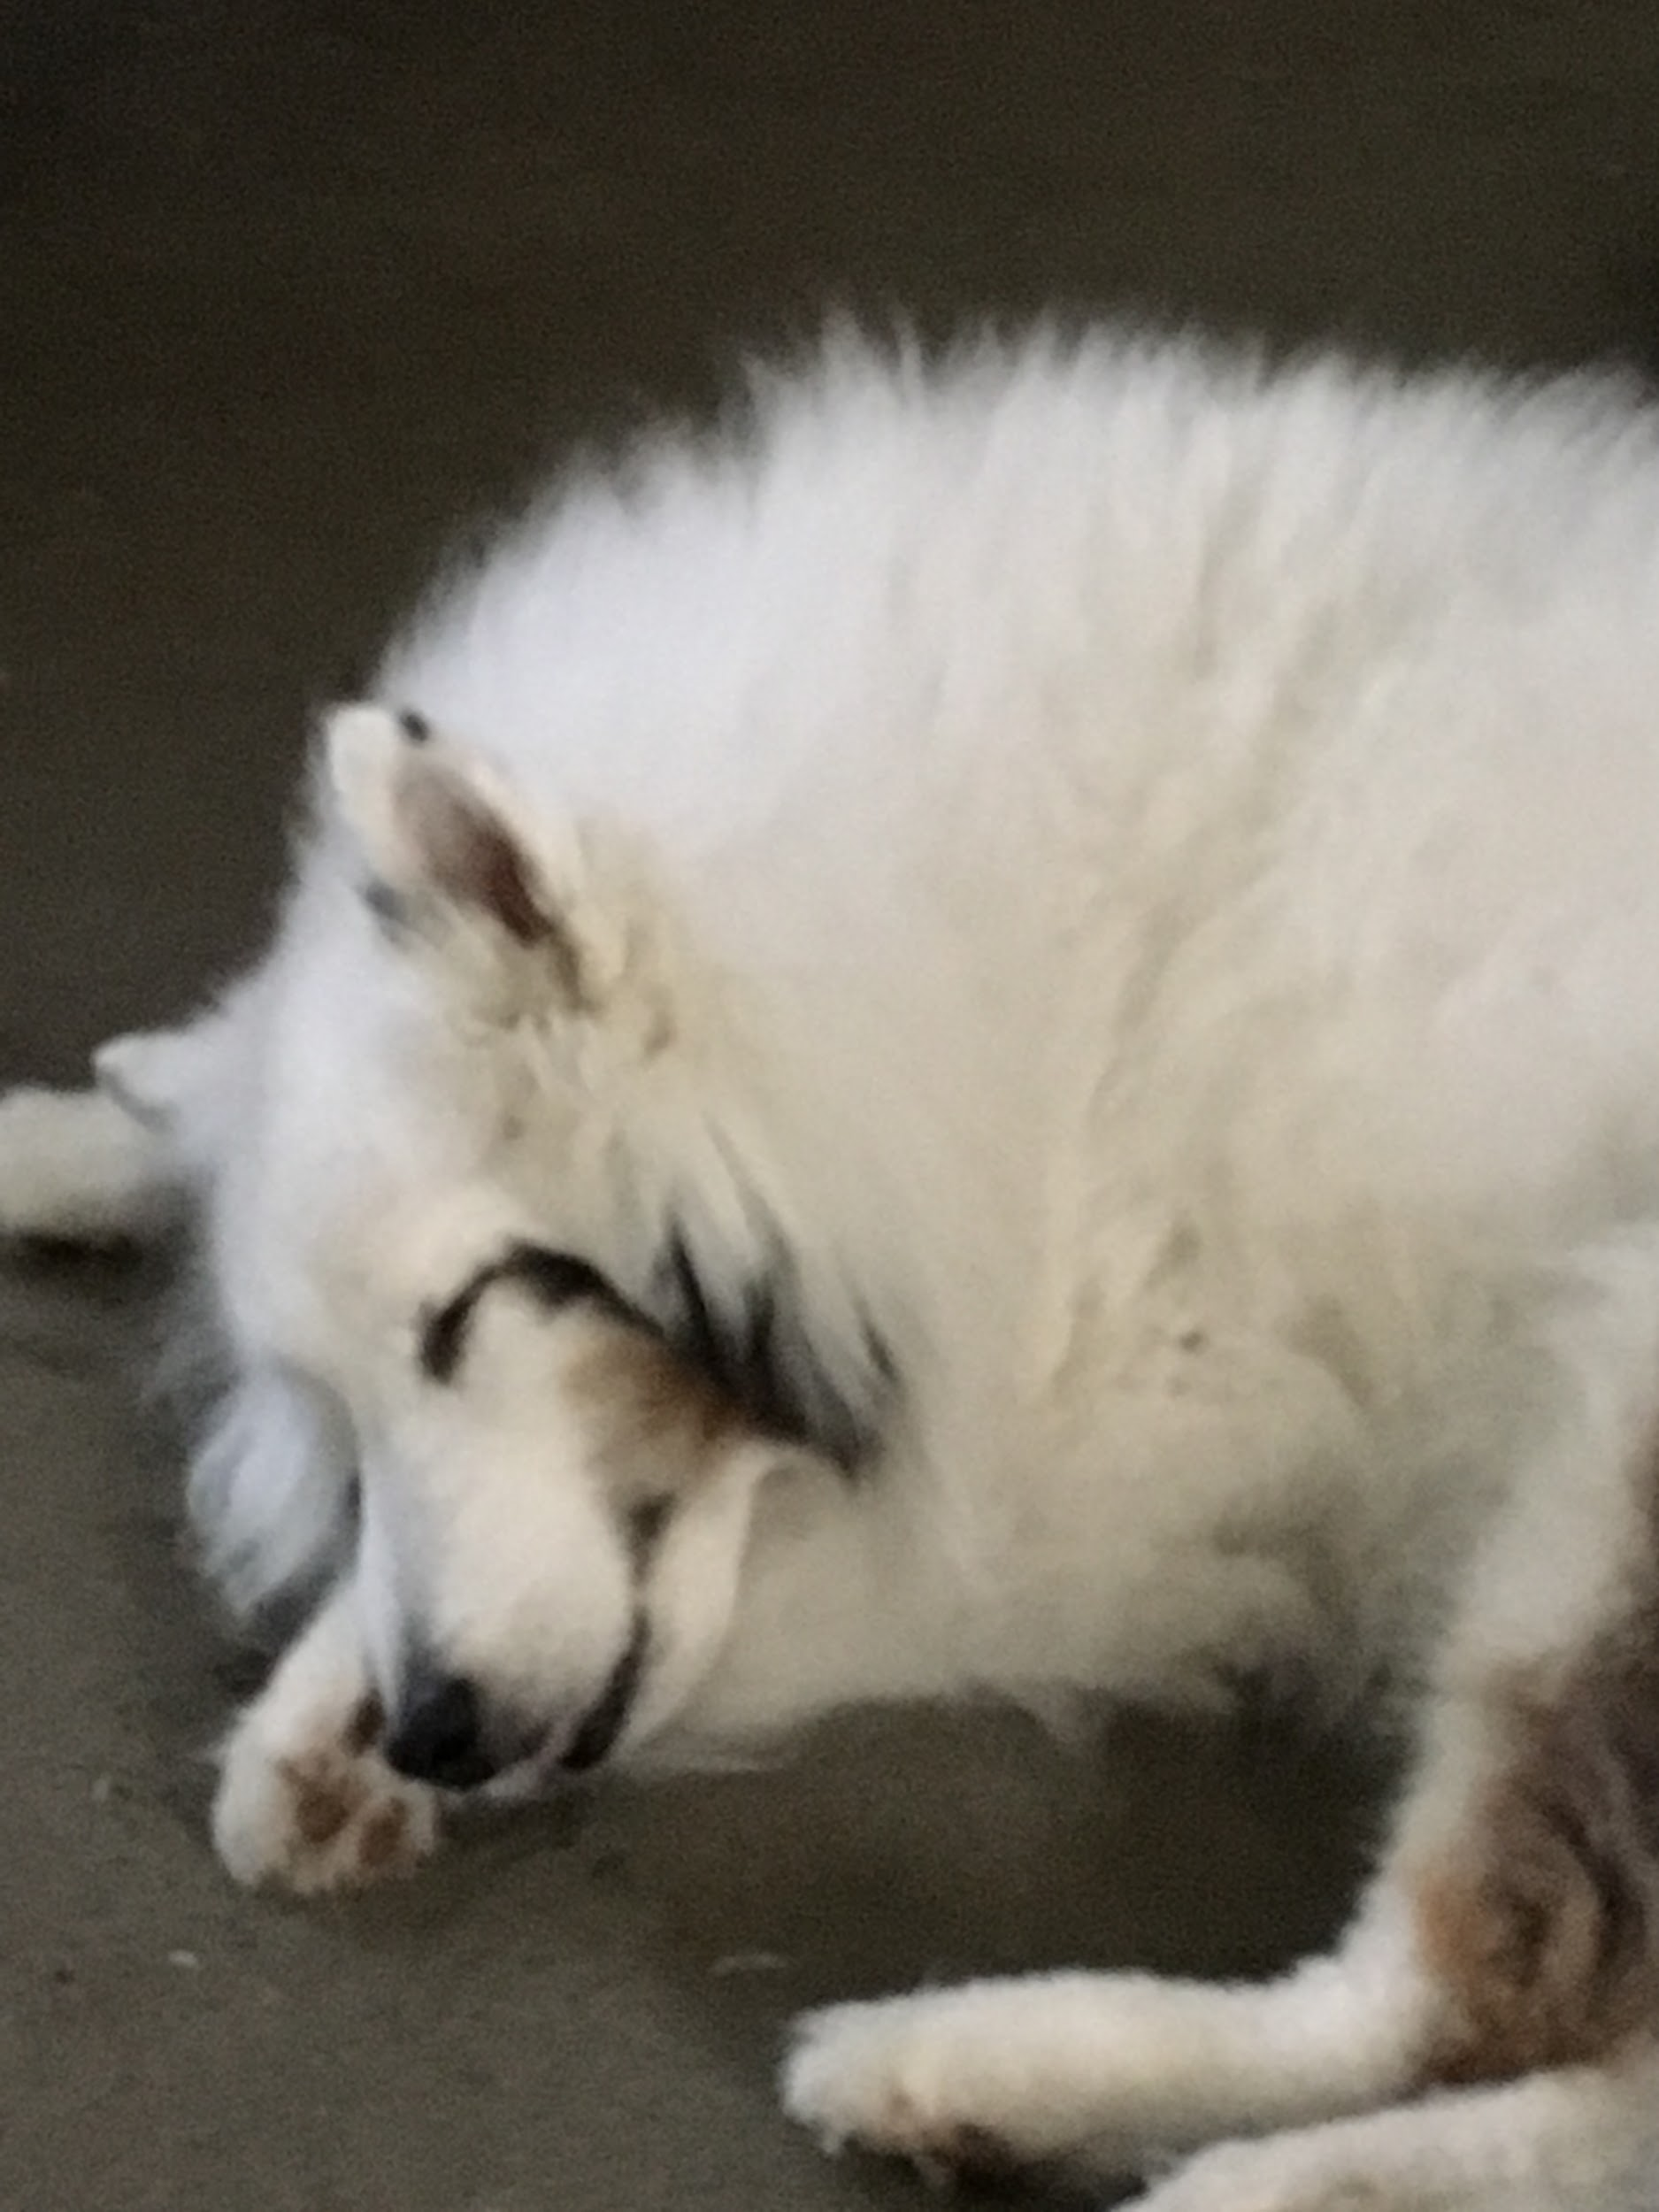
Who Are We?
Yuze Ma
Project Manager
Andrew Leaf
Full Stack
Anjin Lima
Front End Dev
Chelsea Carlson
Front End Dev
Thomas MacIntosh
Back End Dev
Notes:
Yuze

Slide 4
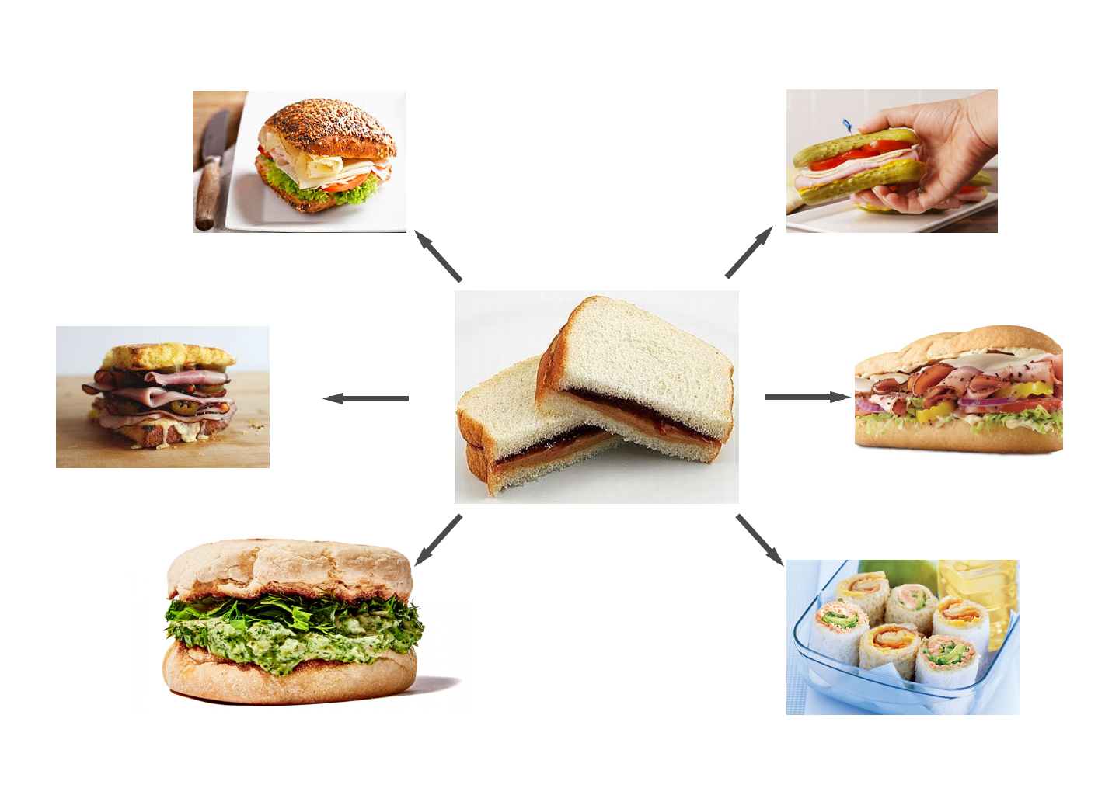
What is Vercipe?
Notes:
Yuze

Slide 5

What is Vercipe?
Notes:
Yuze

Slide 6
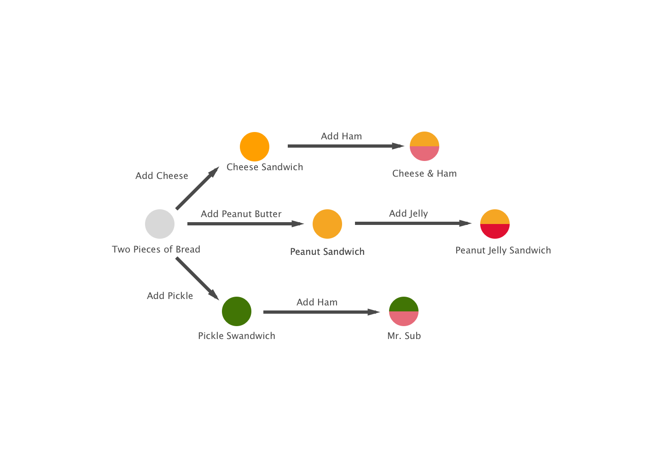
What is Vercipe?
Notes:
Yuze

Slide 7
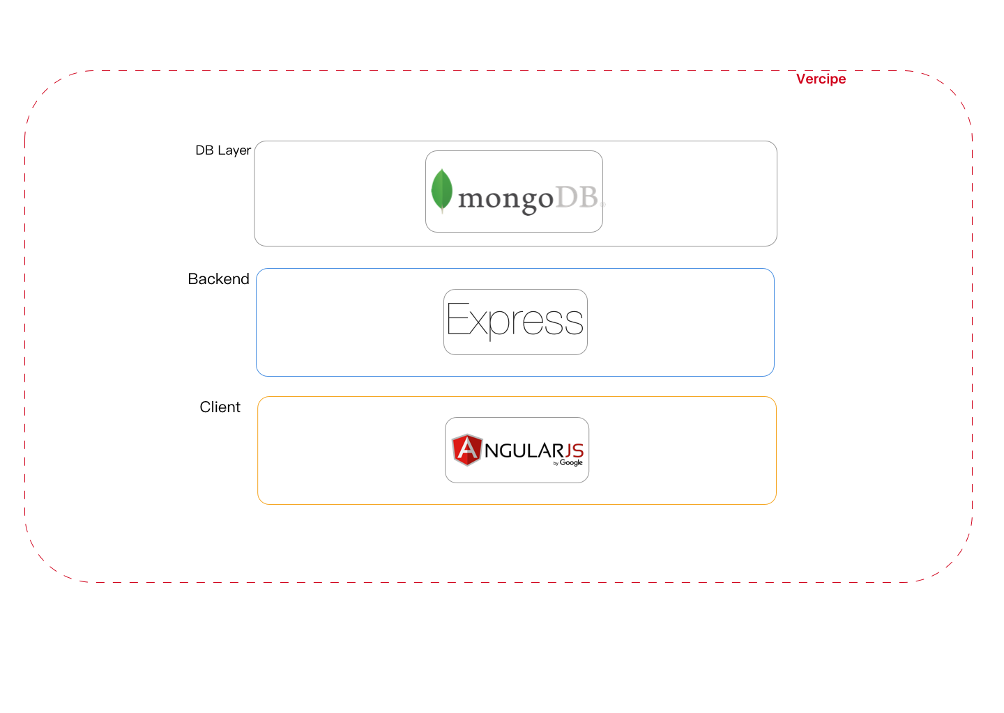

Tech Stack & DevOp
Notes:
Andrew
MongoDB - A nonrelational database used to store our recipes and user info such as username and password. We chose a nonrelational database because recipes can have many different parts, making storing them as documents instead of in a table easier, object oriented, every recipe is distinct from another one
Express - a server we decided to use because it’s lightweight and easy to learn
Angular - we used angular to help display information on the front end and to make interacting with the backend easier. We chose Angular over AngularJS to try new things

Slide 8

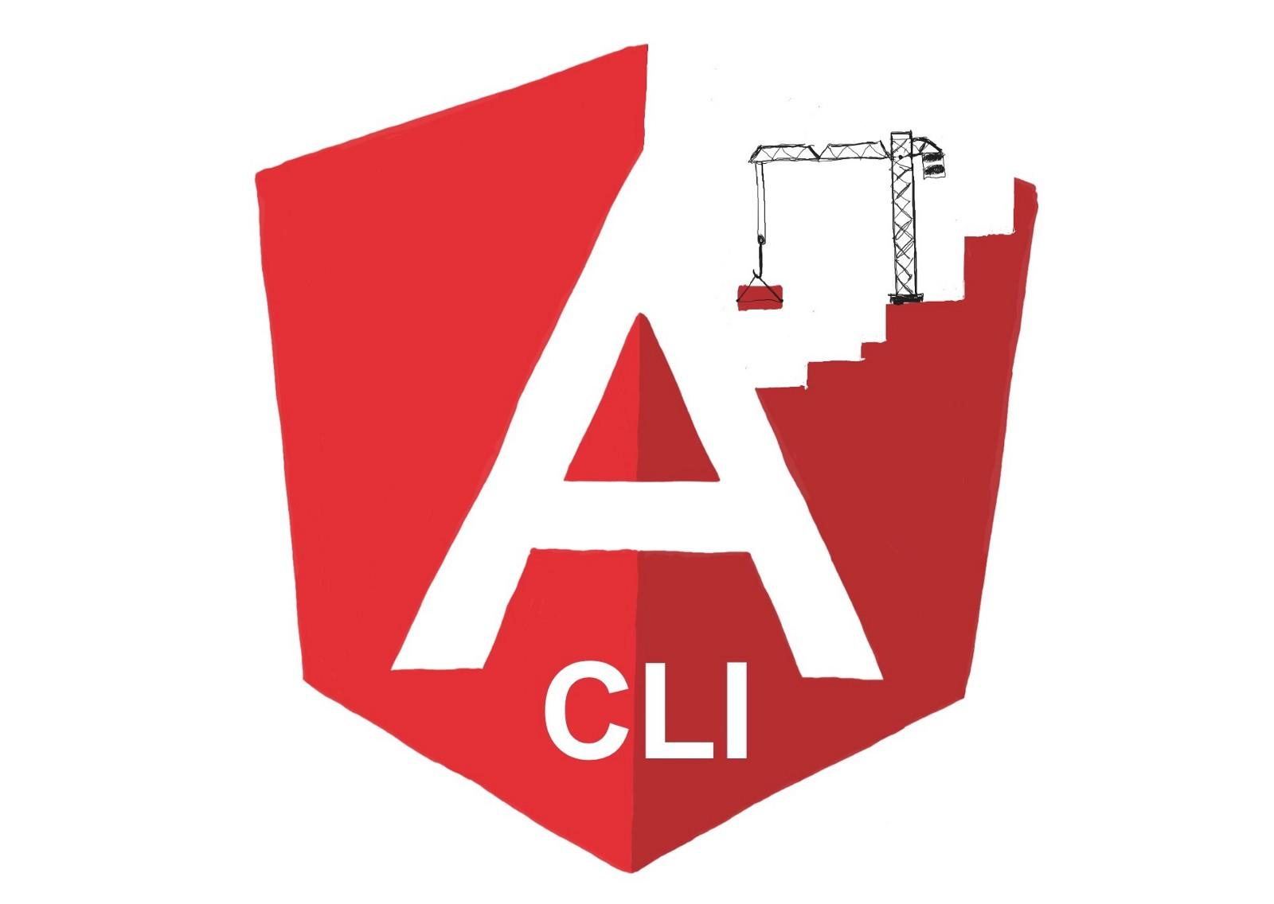

Tech Stack & DevOp
Dev Env Control
Frontend Build Tool
Version Control
Notes:
Andrew
Docker - We used docker as environmental control for our backend. When using mongo, there can easily be inconsistencies in configuration files on different computers. Docker allowed us to stay on the same page. Saved a lot of time. Could start up backend with one command, instead of individually starting all processes
Angular CLI - We used Angular CLI in order to easy create and add new components onto the site along with compiling our front end so it can be served to the user, tool to build the front end project easier. We could easily add pages to the website by adding components. Ng newcomponent. We could also make new services easily wit ng newservice
Git - To keep track of our code and to allow us to recover from mistake, team collaboration

Slide 9
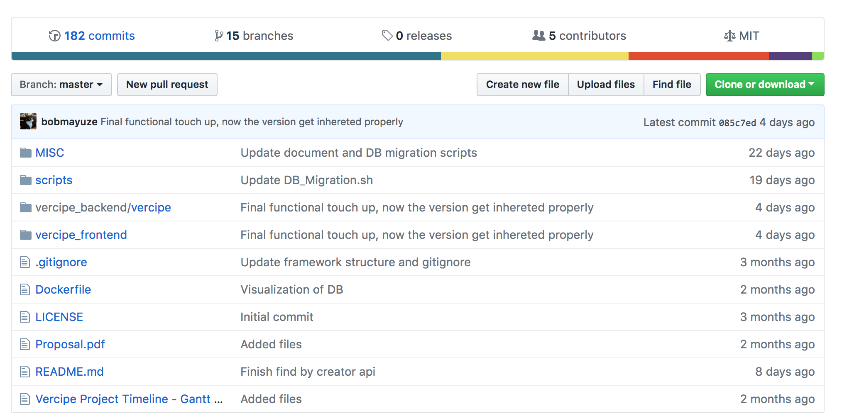
Tech Stack & DevOp
Notes:
Andrew
Github - to host our project

Slide 10
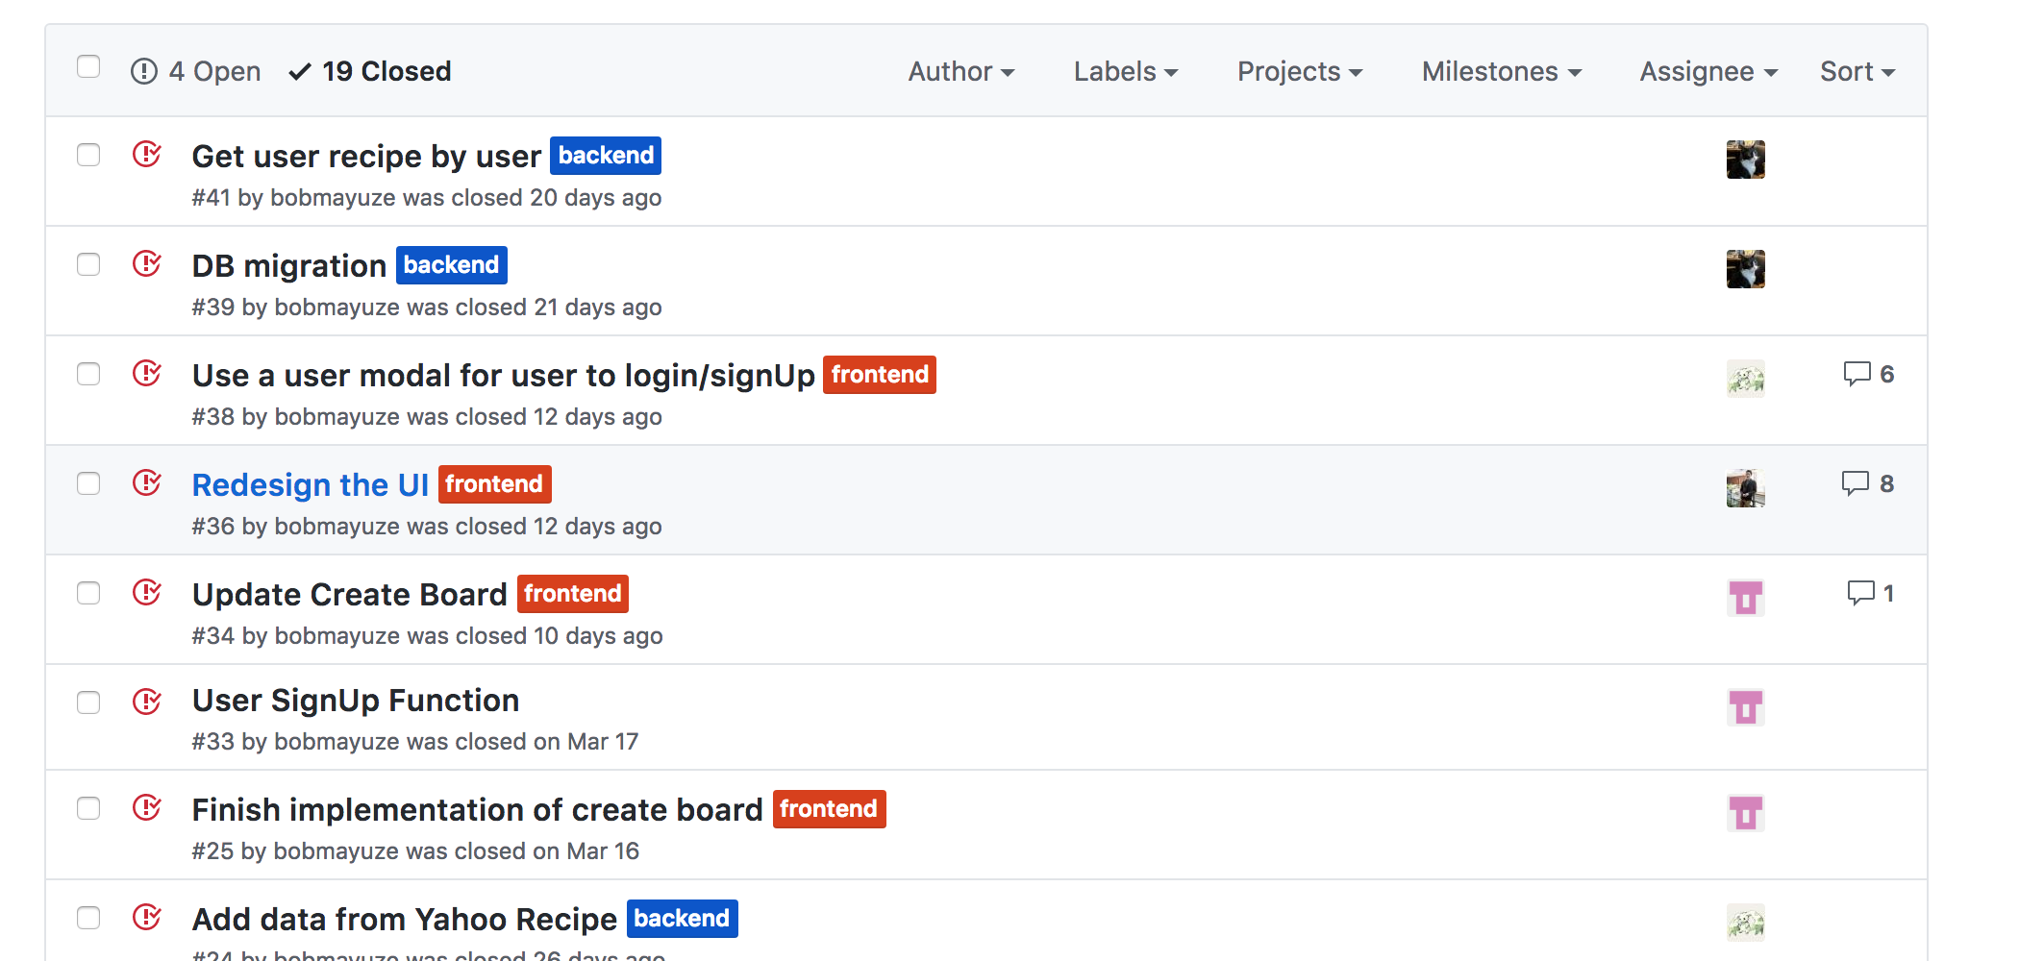
Tech Stack & DevOp
Notes:
Andrew
Issues to keep track of what needs to be done and to communicate with team on what needs to be done - conversations

Slide 11
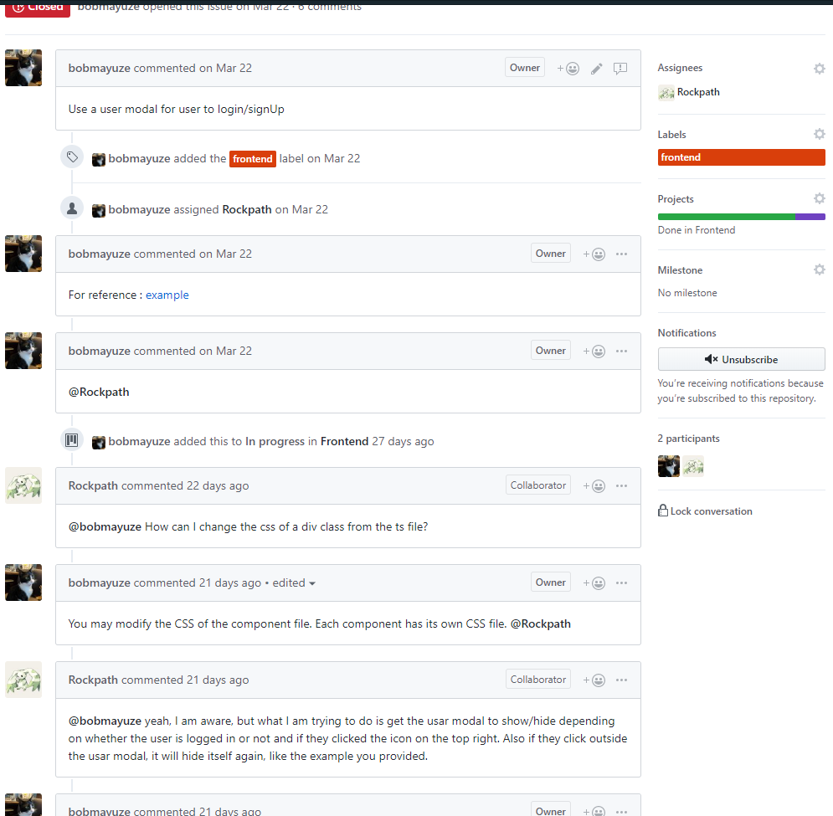
Tech Stack & DevOp

Slide 12
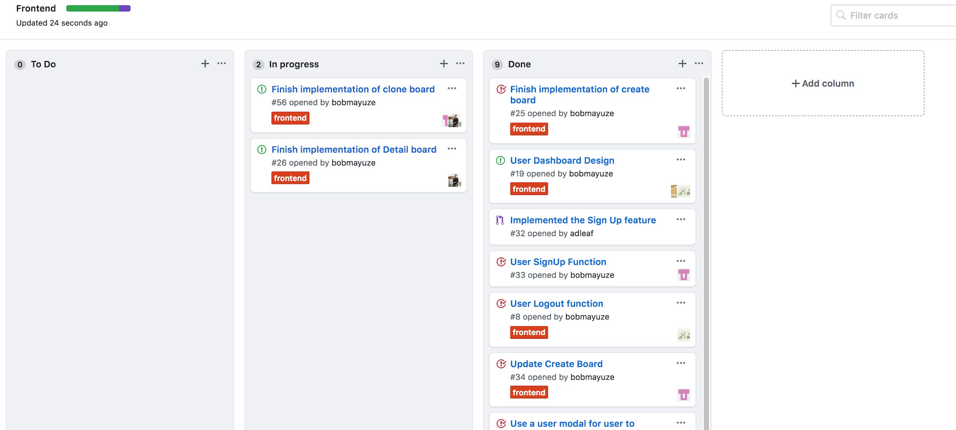
Tech Stack & DevOp
Notes:
Andrew end, switch to Chelsea
SCRUM - We used this to keep track of what everyone was doing throughout the week between weekly meetings as part of our SCRUM development methodology
Project board - to visually keep track of what needs to be done, what’s being worked on, and what’s done also who did what

Slide 13
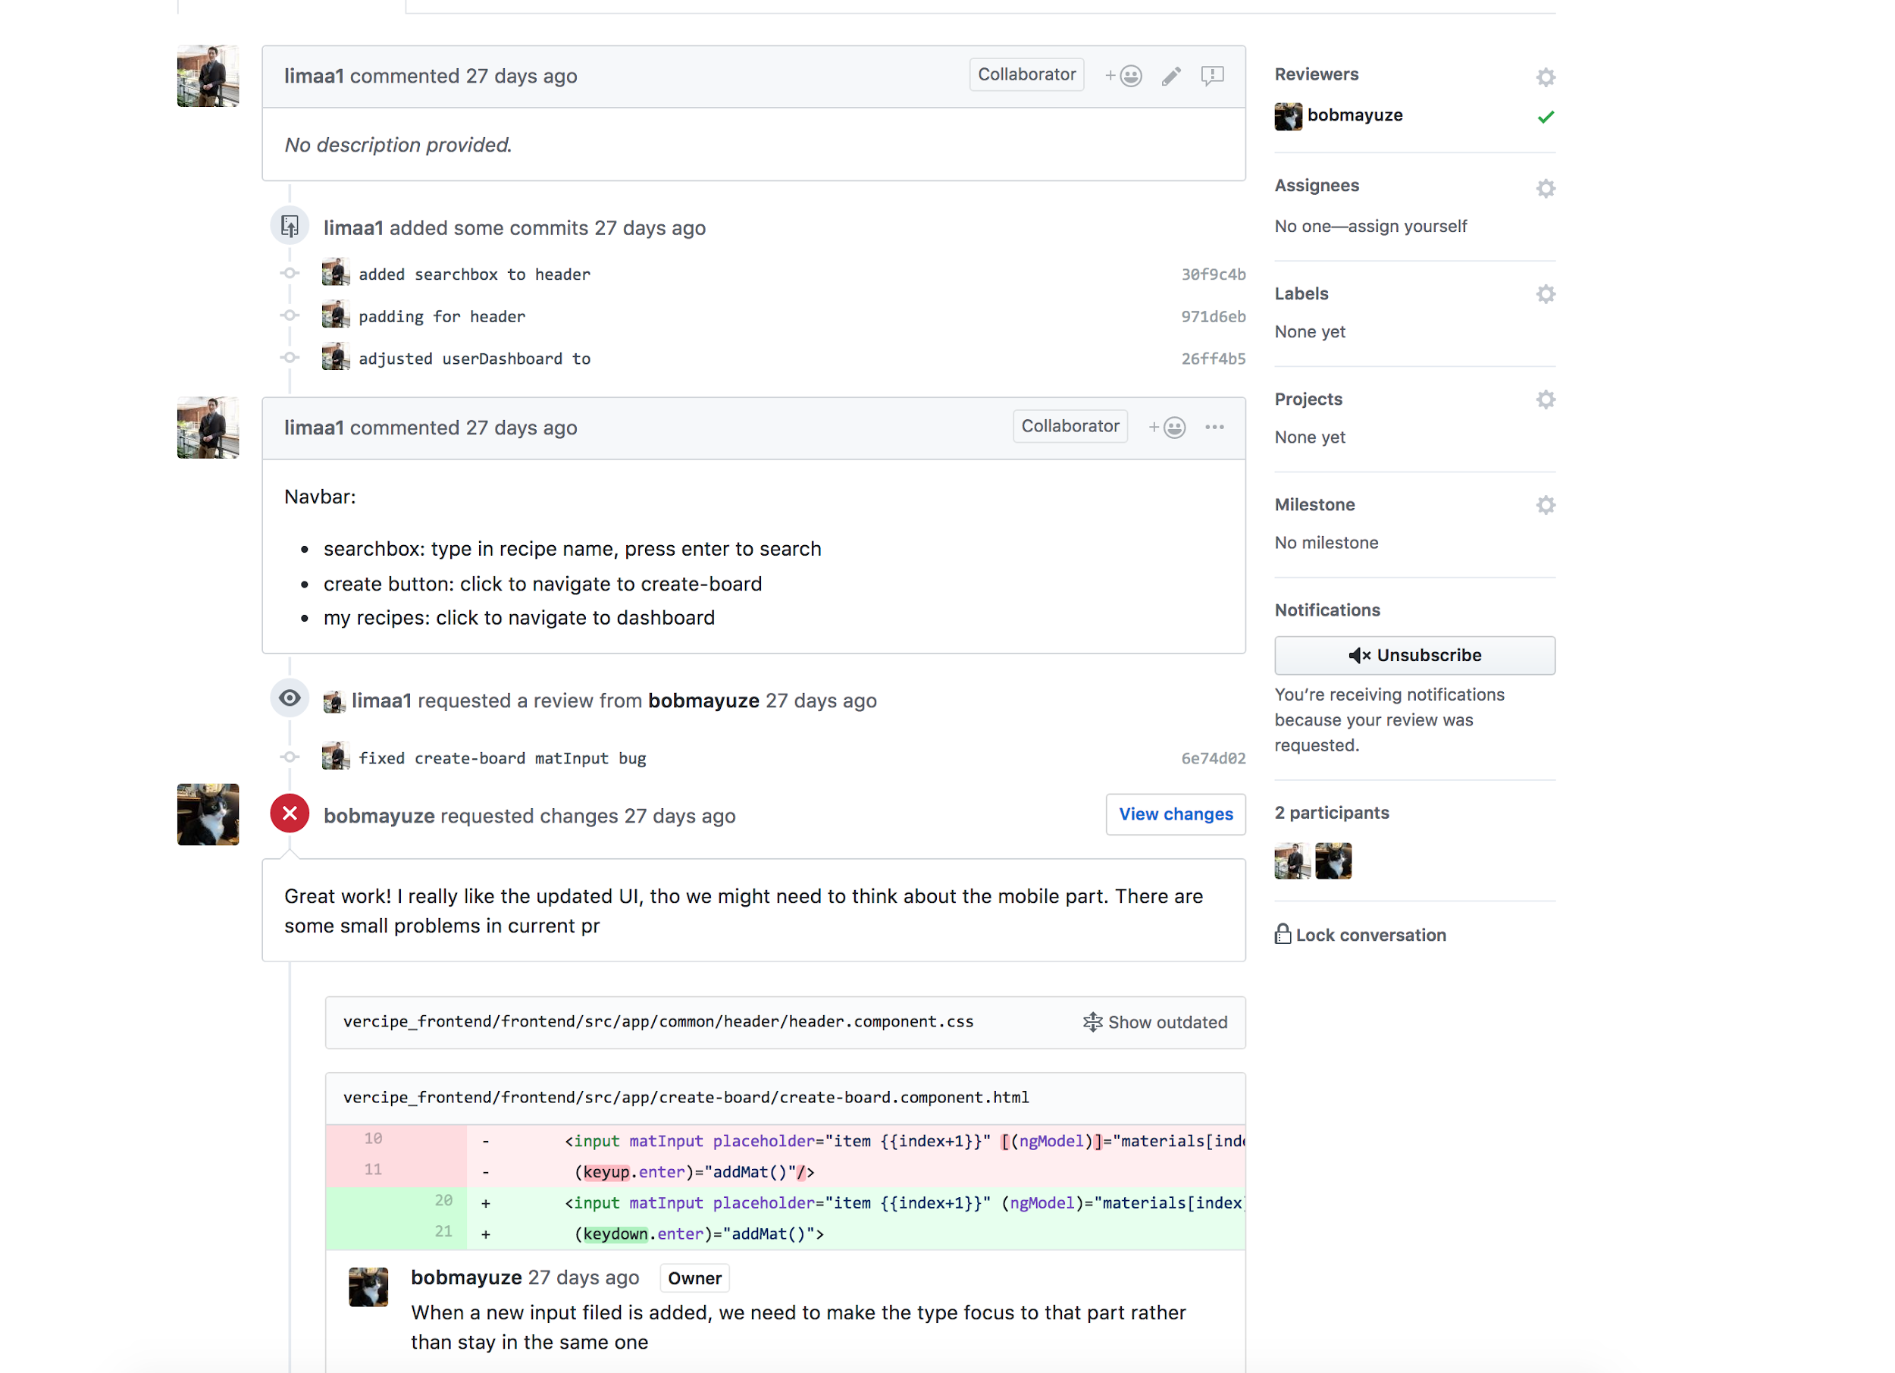
Tech Stack & DevOp

Slide 14
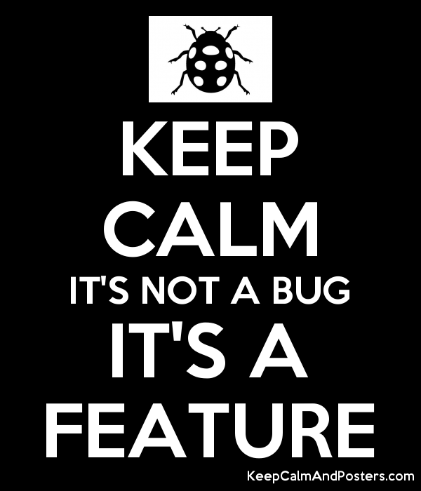
Milestones and Progress Report
It’s not a bug. It is a feature.
-- Mohammed Moftah
Notes:
Chelsea

Slide 15
Prototype
Pres
Improvements
Pres
Docs
Week 1
Week 2
Week 3
Week 4
Week 5
Week 6
Week 7
Week 8
Week 9
Week 10
Week 11
Week 12
Dev Env Setup
Landing Page
Recipe Clone
Recipe Edit Page
Presentation
Login, Landing
Recipe Vrs, Edit
Search Page
Final Fixes
User Testing
Presentation
Documentation
Notes:
Chelsea

Slide 16
Milestones
Finished Core Backend Features and Frontend Setup
Initialized the Project
Finish all core features
Jan, 24th
Feb, 15th
Mar, 5th
April, 2nd
April, 15th
Finished Dev Env Control and Backend Setup
Rebuild Frontend
Notes:
Chelsea
Core Backend - Fork recipes, clone recipes, create recipes
In between march 5th and April second it was decided to rebuild the front end to make the design more user friendly and have a more polished appearance
This past week all of the core features for working with recipes was finished on the front end and linked to the backend.

Slide 17

Progress Report: Data Resource
Curated recipes from allrecipes.com
Selected most popular recipes from a variety of categories
Converted recipes into our desired format
Initially had problems exporting recipes
Resolved by manually exporting.
Loads JSON file at initialization
Notes:
Thomas
One command upload all data

Slide 18
Progress Report
Features to highlight:
Version Jump
Focus text fields
Notes:
Anjin

Slide 19
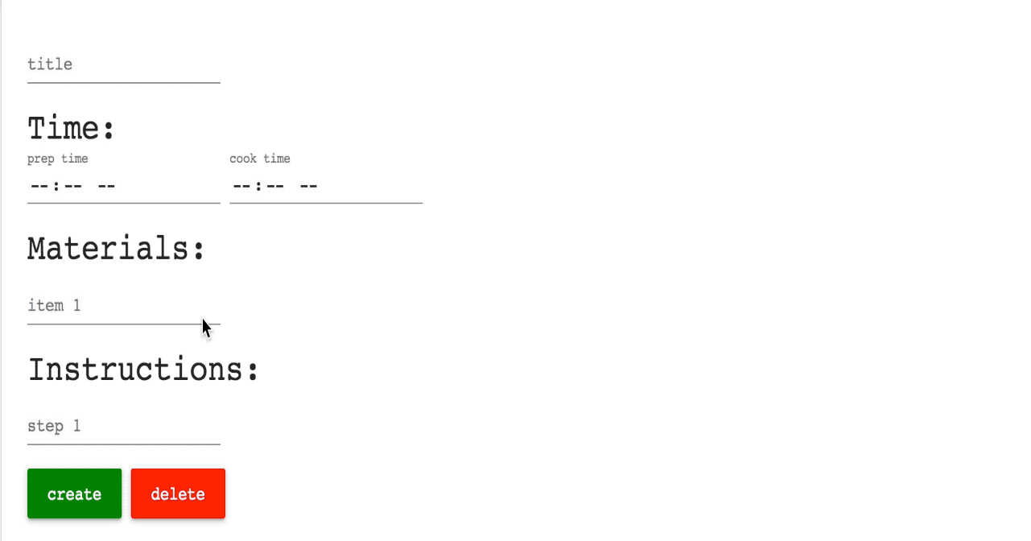
Focus on new text field
Notes:
A UI feature we decided to add was focusing on the generation of a new text field
When a user wants to add ingredients or instructions to a recipe, they can press enter while they are in a text field to generate a new field
But by default the text field be created beneath them and then they would need to click or tab to the new field
We were able to use an angular directive, which is essentially a layer of reusable logic that we can add to components, to focus on a new text field once it has been initialized

Slide 20
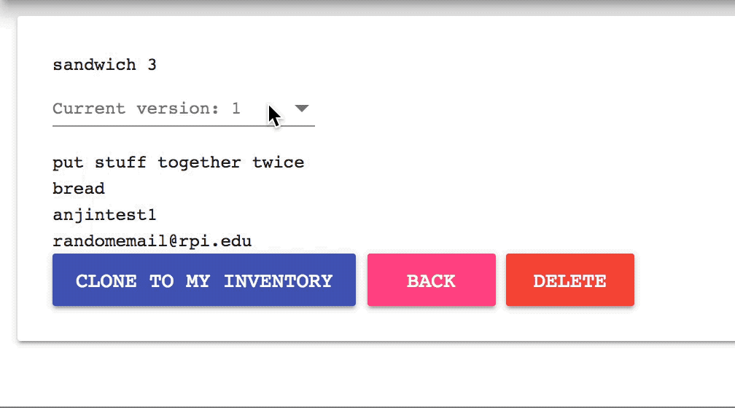
Version Jump (view ancestors)
Notes:
When a user clones a recipe we simply add 1 to the previous id and link the the original recipe as the previous
So on the recipe page users can easily navigate to previous versions
but this does generate an issue of cloning the same recipe twice and having duplicate recipe versions which is something that we did not address
the dropdown menu is also not complete, as it simply shows the recipe’s unique id and not the recipe version

Slide 21
Demo
That’s a word I’ve not heard in a long time.
Notes:
Yuze

Slide 22
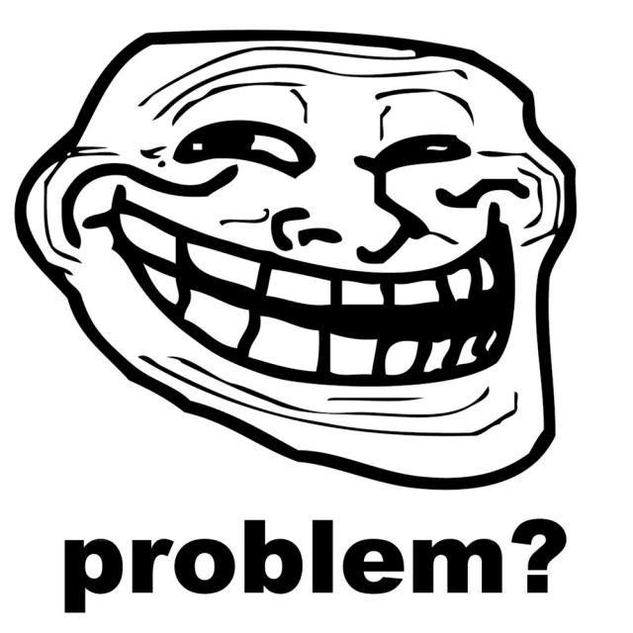
Problems we met during the Development
Notes:
Andrew

Slide 23
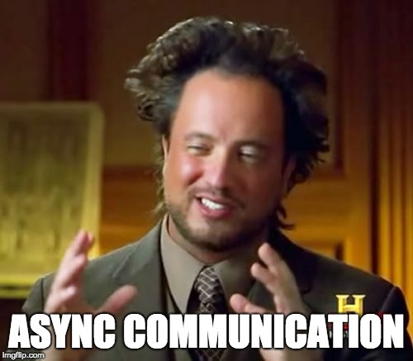
Problems we met during the Development
Notes:
Yuze
Problem: We were all working on different parts of the project at the same time, leading to times where we two people edited the same parts at the same time. It was also difficult all being on the same page when it came to communicating through messenger because not everyone checked it very often, leading to people not being caught up on what’s going on.
Even though we were sometimes conflicts when merging the code, working asynchronously allowed us to make more progress than otherwise.

Slide 24
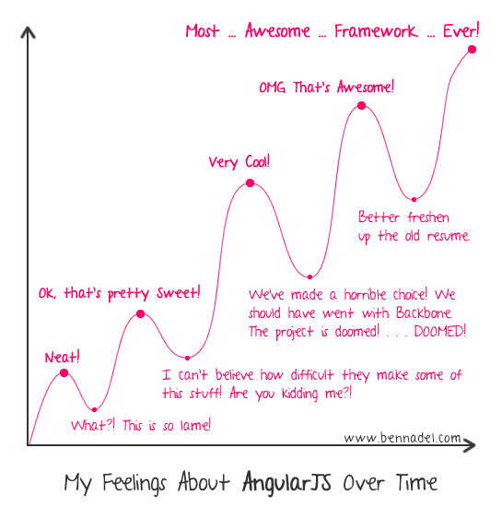
Problems we met during the Development
Notes:
Anjin
We didn’t know what exactly came with angular at the beginning and what came with it.

Slide 25
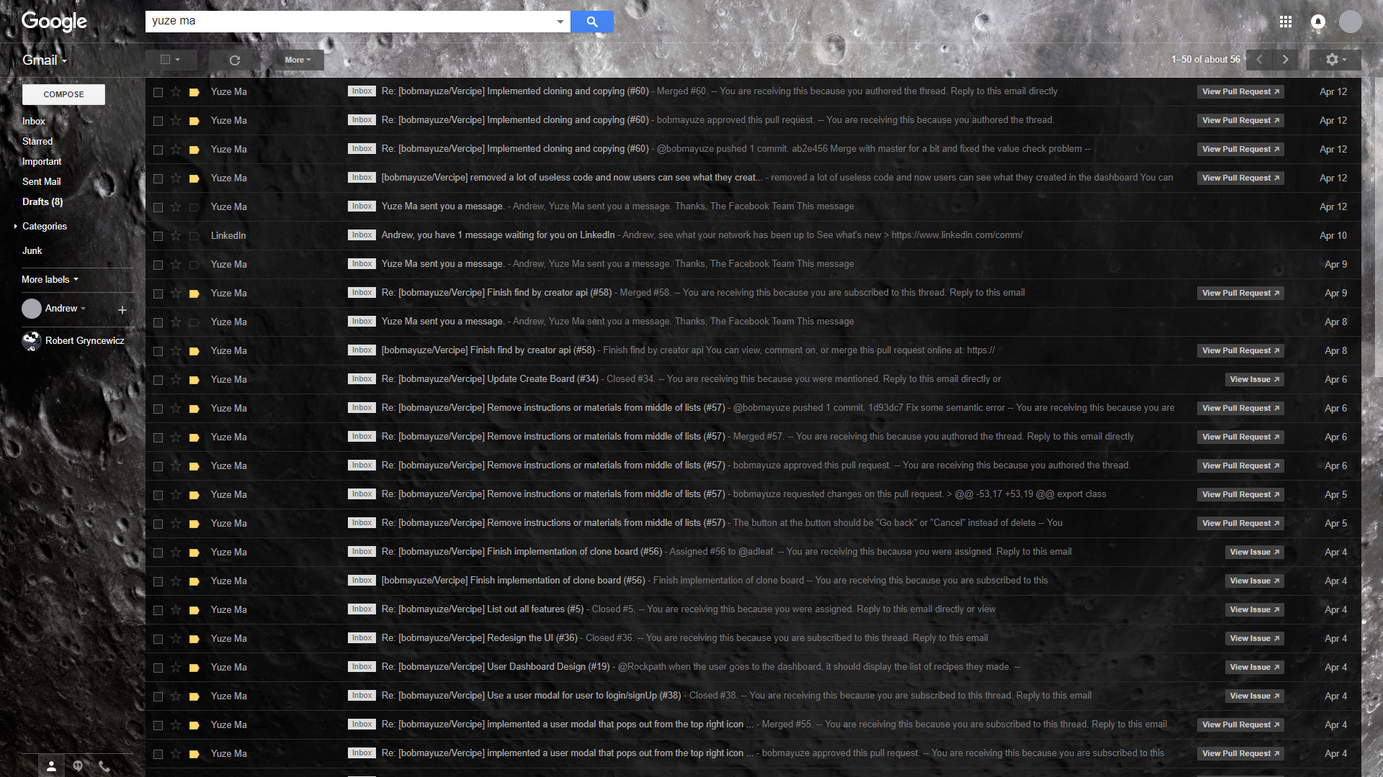
Problems we met during the Development
Notes:
Inbox Storage
A lot of commits were made and being signed up for notifications from the repository meant getting spammed from github
Started off reading the emails, but after getting 100s of emails, people weren’t as motivated to read through them all

Slide 26
Future Development Plan
It’s not a bug. It is a feature.
-- Mohammed Moftah
Notes:
Thomas

Slide 27

Future Development Plan
Possible Features/Improvements:
Basic UI/CSS improvements
Recipe Recommendations
Pull recipes via API from various recipes databases
User features:
Following favorite creators/recipes
Sharing recipes via social media
Favorite recipe lists
Messaging
Notes:
Thomas

Slide 28
Future Development Plan
Create board
Autofill ingredients/amounts
Suggest ingredients/amounts
Recipe Templates
Save-for-later option
Notes:
Thomas

Slide 29
Thanks
Questions?

